Slide 1
DATA BASE MANAGEMENT SYSTEM

Slide 2
Introduction to DBMS
What is Database & DBMS?
The need for a database
The File-Based Systems
Features of DBMS
Usage of Database

Slide 3
Database
It can be defined as the storage of inter related data that has been organized in such a fashion that the process of retrieving data is effective and efficient

Slide 4
Database Management System (DBMS)
DBMS contains information about a particular enterprise
Collection of interrelated data
Set of programs to access the data
An environment that is both convenient and efficient to use
Database Applications:
Banking: all transactions
Airlines: reservations, schedules
Universities: registration, grades
Sales: customers, products, purchases
Online retailers: order tracking, customized recommendations

Slide 5
Purpose of Database Systems
In the early days, database applications were built directly on top of file systems
Drawbacks of using file systems to store data:
Data redundancy and inconsistency
Difficulty in accessing data
Data isolation — multiple files and formats
Integrity problems

Slide 6
Purpose of Database Systems (Cont.)
Drawbacks of using file systems (cont.)
Atomicity of updates
Failures may leave database in an inconsistent state with partial updates carried out
Example: Transfer of funds from one account to another should either complete or not happen at all
Concurrent access by multiple users
Concurrent access needed for performance
Uncontrolled concurrent accesses can lead to inconsistencies
Example: Two people reading a balance and updating it at the same time
Security problems
Hard to provide user access to some, but not all data
Database systems offer solutions to all the above problems

Slide 7
DBMS Architecture
Three-level architecture of DBMS
The functions of Database Systems
Overall system architecture

Slide 8
Levels of Architecture
Physical level: describes how a record (e.g., customer) is stored.
Logical level: describes data stored in database, and the relationships among the data.
type customer = record
customer_id : string; customer_name : string; customer_street : string; customer_city : string;
end;
Application/View level: application programs hide details of data types, also hides information (such as an employee’s salary) for security purposes.

Slide 9
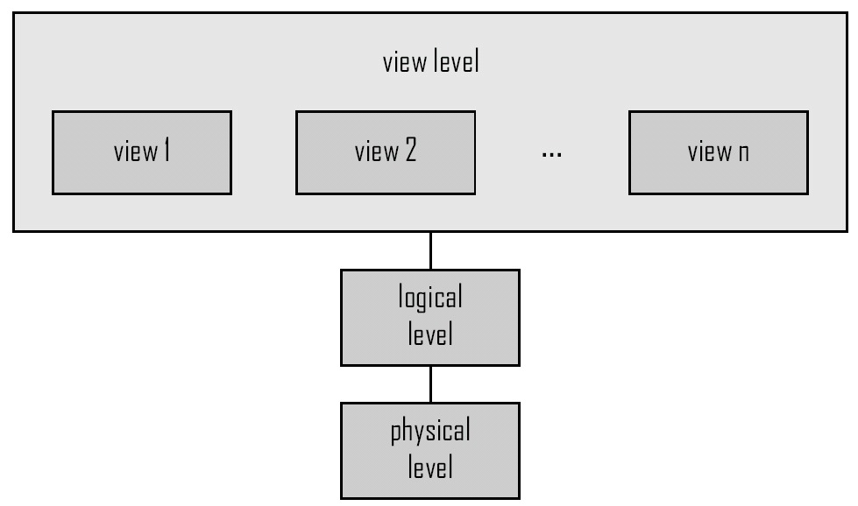
View of Data
An architecture for a database system

Slide 10
Introduction to Data Modeling
Explain the structure of Data
Explain the process of data access in various data-models
Explain the steps involved in the database designing pattern
Design a Conceptual database using ER model

Slide 11
Data Models
A collection of tools for describing
Data
Data relationships
Data semantics
Data constraints

Slide 12
Data Model
Types
Hierarchical DBMS
Network DBMS
Relational DBMS
Object Relational DBMS
Multimedia
Hypertext based databases

Slide 13
Hierarchical Data Model
Defintion
A hierarchical data model is a model that organizes data in a hierarchical tree structure.
Description
A hierarchical tree structure is made up of nodes and branches.
The dependent nodes are at lower levels in the tree.

Slide 14
Hierarchical Data Model
Structure of Model
ROOT Node
Level I
Level II
Level III
LEAF nodes

Slide 15
Network Data Model
Definition
The network data model interconnects the entities of an enterprise into a network.
Description
A block represents an entity or record type. Each record type is composed of zero, one, or more attributes.
Record Type
Set Type

Slide 16
Network Data Model
Description
A directed arrow connects two or more record types and is used to represent a set type.
The record type located at the tail of the arrow is called owner record type, and the record type located at the head of the arrow is called member record type.
A set type shows a logical one-to-many relationship between an owner and a member.

Slide 17
Relational Model
The most common model, the relational model sorts data into tables, also known as relations, each of which consists of columns and rows. Each column lists an attribute of the entity in question, such as price, zip code, or birth date. Together, the attributes in a relation are called a domain. A particular attribute or combination of attributes is chosen as a primary key that can be referred to in other tables, when it’s called a foreign key.

Slide 18
Database Design
The process of designing the general structure of the database:
Logical Design – Deciding on the database schema. Database design requires that we find a “good” collection of relation schemas.
Business decision – What attributes should we record in the database?
Computer Science decision – What relation schemas should we have and how should the attributes be distributed among the various relation schemas?
Physical Design – Deciding on the physical layout of the database

Slide 19
Important Terms in Relational Model
Relation
a table
Tuple
a row in a table
Attribute
a Column in a table
Degree
number of attributes
Cardinality
number of tuples
Primary Key
a unique identifier for the table
Notes:
Relation
a table
Tuple
a row in a table
Attribute
a Column in a table
Degree
number of attributes
Cardinality
number of tuples
Primary Key
a unique identifier for the table

Slide 20
E-R Modeling
Entity
is anything that exists and is distinguishable
Entity Set
a group of similar entities
Attribute
properties that describe an entity
Relationship
an association between entities
Notes:
Entity
is anything that exists and is distinguishable
Entity Set
a group of similar entities
Attribute
properties that describe an entity
Relationship
an association between entities

Slide 21
Notations
ATTRIBUTE
ENTITY TYPE ( REGULAR )
WEAK ENTITY TYPE
RELATIONSHIP TYPE
WEAK RELATIONSHIP TYPE

Slide 22
Types of relationships

Slide 23
ER Model
ssn
name
lot
since
budget
did
dname
Works_in
Employee
Department
Sub-
ordinate
Supervisor
Reports_To

Slide 24
Ternary Relationships
ssn
name
lot
since
did
dname
budget
Works_in
Employee
Department
Location
address
capacity

Slide 25
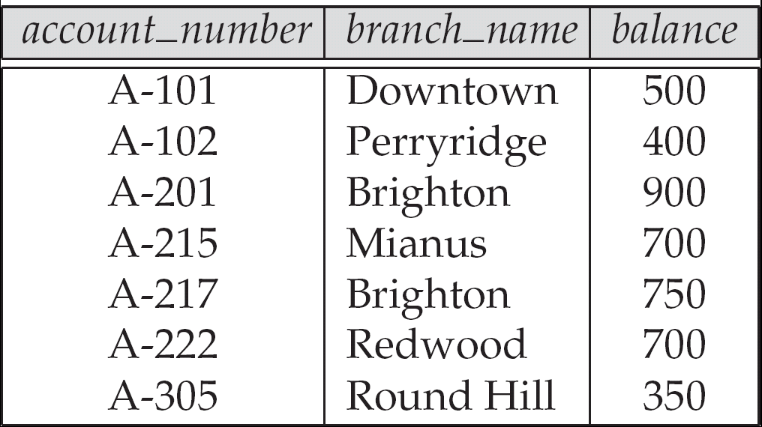
Example of a Relation

Slide 26
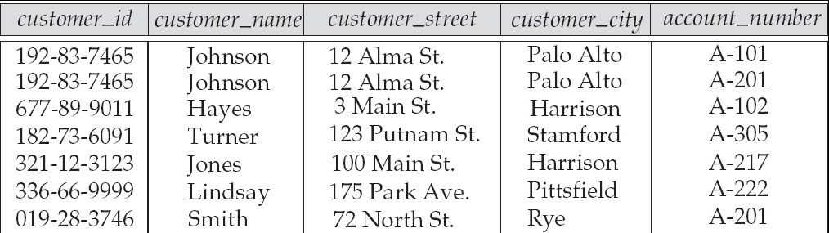
Relational Model
Example of tabular data in the relational model
Attributes

Slide 27
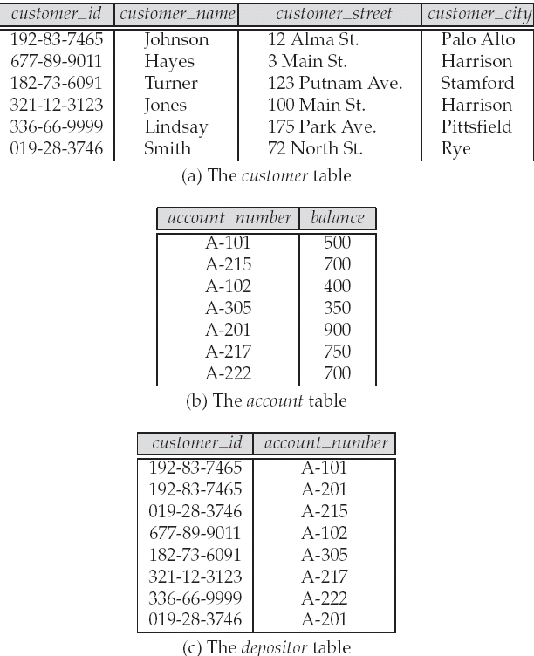
A Sample Relational Database

Slide 28
Normalization
Normalization:
Decomposing a larger, complex table into several smaller, simpler ones
Move from a lower normal form to a higher Normal form
Normal Forms:
First Normal Form (1NF)
Second Normal Form (2NF)
Third Normal Form (3NF)
*Higher Normal Forms (BCNF, 4NF, 5NF ....)
In practice, 3NF is often good enough
Notes:
What is Normalization?
Normalization is the process of efficiently organizing data in a database.
There are two goals of the normalization process:
eliminating redundant data (for example, storing the same data in more than one table) and
ensuring data dependencies make sense (only storing related data in a table).
Both of these are worthy goals as they reduce the amount of space a database consumes and ensure that data is logically stored.

Slide 29
Why Normalization
Redundancy is at the root of several problems associated with relational schemas
More seriously, data redundancy causes several anomalies: insert, update, delete
Wastage of storage
Notes:
Redundancy is at the root of several problems associated with relational schemas
More seriously, data redundancy causes several anomalies: insert, update, delete
Wastage of storage.

Slide 30
First Normal Form
A table is in 1NF, if every row contains exactly one value for each attribute
Disallow multivalued attributes, composite attributes and their combinations
By definition, any relational table must be in 1NF
Notes:
First Normalization Form:
Normalization simply says that all of the data value must be atomic means there should not be repeated columns.
First Normal form says remove all repeating groups from the table.
So in first normal form all the repeating groups eliminated.
Here you can define the primary key.

Slide 31
Second Normal Form (2NF)
A relation schema R is in 2NF if:
it is in 1NF and
every non-prime attribute A in R is fully functionally dependent on the primary key of R
2NF prohibits partial dependencies
Notes:
Second Normalization Rule:
Tables should be in first form.
Now remove all the columns which are not dependent on the primary key so that all rows uniquely identified each of them.

Slide 32
2NF: An Example
Emp{Eno, Dept, ProjCode, Hours}
Primary key: {Eno, ProjCode}
{Eno} -> {Dept}, {Eno, ProjCode} -> {Hours}
Test of 2NF
{Eno} -> {Dept}: partial dependency
Emp is in 1NF, but not in 2NF
Decomposition:
Emp {Eno, Dept}
Proj {Eno, ProjCode, Hours}

Slide 33
Third Normal Form
A relation schema R is in 3NF if
It is in 2NF and
No nonprime attribute of R is transitively dependent on the primary key
3NF prohibits transitive dependencies

Slide 34
3NF: An Example
Emp{Eno, Dept, Dept_Head}
Primary key: {Eno}
{Eno} -> {Dept}, {Dept} -> {Dept_Head}
Test of 3NF
{Eno} -> {Dept} -> {Dept_Head}: Transitive dependency
Emp is in 2NF, but not in 3NF
Decomposition:
Emp {Eno, Dept}
Dept {Dept, Dept_Head}
Notes:
Third normal Form:
Table should be in second normal form and here you can remove all the columns from table which are interdependent.
In other word all rows should be dependant upon the primary key.

Slide 35
KEYS concept in RDBMS
There are different types of keys we can use in SQL SERVER which are as follows:-
• Super Key • Candidate Key • Primary Key • Alternate key • Composite/Compound Key • Unique Key • Foreign Key

Slide 36
Super Key
Super key can be defined as a set of one or more than one keys that can be used to identify a record/data uniquely in a table. This key includes only those fields which includes unique value.
For example : Employee table Employee_Id will be the field which includes unique value and it become easy to identify the employee from Employee_Id field.
Keys which can be the subset of Super Key are Primary key, Unique key and Alternate key.

Slide 37
Super Keys
K is a superkey of R if values for K are sufficient to identify a unique tuple of each possible relation r(R)
by “possible r ” we mean a relation r that could exist in the enterprise we are modeling.
Example: {customer_name, customer_street} and {customer_name} are both superkeys of Customer, if no two customers can possibly have the same name

Slide 38
Candidate Keys
K is a candidate key if K is minimal Example: {customer_name} is a candidate key for Customer, since it is a superkey and no subset of it is a superkey.
Primary key: a candidate key chosen as the principal means of identifying tuples within a relation
Alternate key: a candidate key that is not the primary key, but has potential to be one later.
Composite key: A key that has got more than 1 attributes within it.

Slide 39
Foreign Keys
A relation schema may have an attribute that corresponds to the primary key of another relation. The attribute is called a foreign key.
E.g. customer_name and account_number attributes of depositor are foreign keys to customer and account respectively.
Only values occurring in the primary key attribute of the referenced relation may occur in the foreign key attribute of the referencing relation.

Slide 40
Integrity Constraints in DBMS
Constraints are the rules enforced on the data columns of a table. These are used to limit the type of data that can go into a table. This ensures the accuracy and reliability of the data in the database.

Slide 41
Domain Integrity Constraint
The domain integrity states that every element from a relation should respect the type and restrictions of its corresponding attribute.
A type can have a variable length which needs to be respected. Restrictions could be the range of values that the element can have, the default value if none is provided, and if the element can be NULL.

Slide 42
Entity integrity
The entity integrity constraint states that no primary key value can be null.
This is because the primary key value is used to identify individual tuples in a relation. Having null value for the primary key implies that we cannot identify some tuples.
This also specifies that there may not be any duplicate entries in primary key column key row.
Eg : create table t1(col 1 …. Primary key,….);

Slide 43
Referential Integrity
The referential integrity constraint is specified between two relations and is used to maintain the consistency among tuples in the two relations.
Informally, the referential integrity constraint states that a tuple in one relation that refers to another relation must refer to an existing tuple in that relation.
It is a rule that maintains consistency among the rows of the two relations
Eg : every Foreign key value must have a primary key reference in another table.

Slide 44
SQL - Basic Operations
Work with the SQL Data Definition Language (DDL)
Work with the SQL Data Manipulation Language (DML)
Write Queries using SQL select statements
Work with SQL Operators
Work with SQL Functions
TCL
DCL
Notes:
1

Slide 45
History
IBM Sequel language developed as part of System R project at the IBM San Jose Research Laboratory
Renamed Structured Query Language (SQL)
ANSI and ISO standard SQL:
SQL-86
SQL-89
SQL-92
SQL:1999 (language name became Y2K compliant!)
SQL:2003
Commercial systems offer most, if not all, SQL-92 features, plus varying feature sets from later standards and special proprietary features.
Not all examples here may work on your particular system.

Slide 46
Data Definition Language (DDL)
Allows the specification of:
The schema for each relation, including attribute types.
Integrity constraints
Authorization information for each relation.
Non-standard SQL extensions also allow specification of
The set of indices to be maintained for each relations.
The physical storage structure of each relation on disk.

Slide 47
Create Table Construct
An SQL relation is defined using the create table command:
create table r (A₁ D₁, A₂ D₂, ..., A_{n} D_{n},
(integrity-constraint₁), ..., (integrity-constraint_{k}))
r is the name of the relation
each A_{i} is an attribute name in the schema of relation r
D_{i} is the data type of attribute A_{i}
Example:
create table branch (branch_name char(15), branch_city char(30), assets integer)

Slide 48
Data Types in SQL
char(n). Fixed length character string, with user-specified length n.
varchar2(n). Variable length character strings, with user-specified maximum length n.
int. Integer (a finite subset of the integers that is machine-dependent).
number(p,d). Fixed point number, with user-specified precision of p digits, with n digits to the right of decimal point.
real, double precision. Floating point and double-precision floating point numbers, with machine-dependent precision.
float. Floating point number, with user-specified precision of at least n digits.
Date. Date and time values in numeric format of century, year month, day, hour, minute and seconds

Slide 49
Integrity Constraints on Tables
Not null
Primary key
Foreign Key
Unique Key
Check
It can be at a table level or at a column level

Slide 50
Integrity constraints on Tables
Example: Constraints
create table branch (branch_name char(15 ), branch_city char(30) not null, assets integer, primary key (branch_name))
create table employee
(empno char(5) primary key,
ename varchar2(20),
salary number(8,2) check (salary > 5000),
doj date not null,
email varchar(25) unique,
dept_id char(5) foreign key references department(deptid))

Slide 51
Drop and Alter Table Constructs
The drop table command deletes all information about the dropped relation from the database.
The alter table command is used to add attributes to an existing relation:
alter table r add A D
where A is the name of the attribute to be added to relation r and D is the domain of A.
All tuples in the relation are assigned null as the value for the new attribute.
The alter table command can also be used to drop attributes of a relation:
alter table r drop column A
where A is the name of an attribute of relation r
Dropping of attributes not supported by many databases

Slide 52
Table Constructs (cont..)
Rename <tablename> to <new table> : renames any object like table, view etc. You should be the owner of the object
Truncate Table <tablename> : Deletes all rows from the table and releases the storage spaces.
SP_Help /HelpText <Table Name>

Slide 53
Basic Insertion of Tuples
Newly created table is empty
Add a new tuple to account
insert into account values ('A-9732', 'Perryridge', 1200)
Insertion fails if any integrity constraint is violated

Slide 54
Modification of the Database – Insertion
Add a new tuple to account
insert into account values ('A-9732', 'Perryridge', 1200)
or equivalently insert into account (branch_name, balance, account_number) values ('Perryridge', 1200, 'A-9732')
Add a new tuple to account with balance set to null
insert into account values ('A-777','Perryridge', null )

Slide 55
Modification of the Database – Insertion through select
Provide as a gift for all loan customers of the Perryridge branch, a $200 savings account. Let the loan number serve as the account number for the new savings account
insert into account select loan_number, branch_name, 200 from loan where branch_name = 'Perryridge'
insert into depositor select customer_name, loan_number from loan, borrower where branch_name = 'Perryridge' and loan.account_number = borrower.account_number
The select from where statement is evaluated fully before any of its results are inserted into the relation

Slide 56
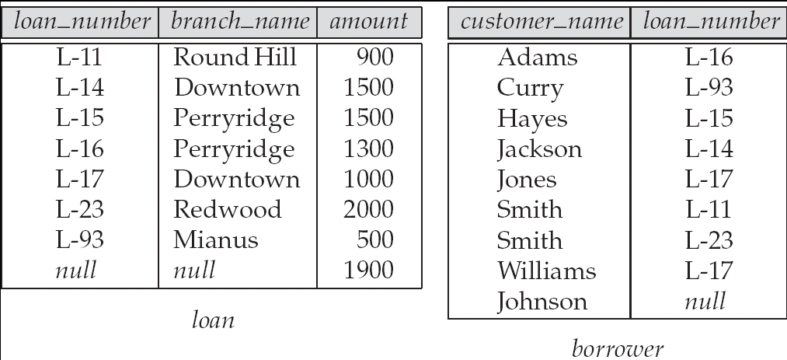
Tuples inserted into loan and borrower

Slide 57
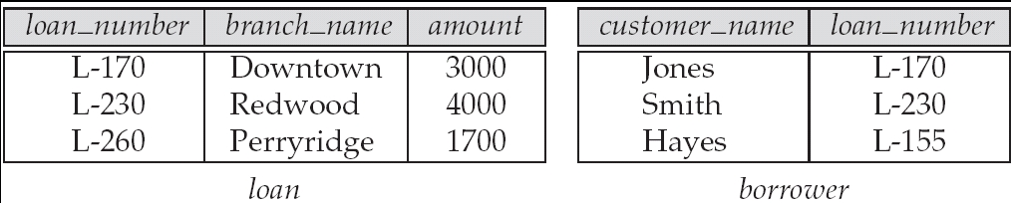
The loan and borrower relations

Slide 58
Modification of the Database – Deletion
Delete all tuples from account
delete from account
Delete all account tuples at the Perryridge branch
delete from account where branch_name = 'Perryridge'
Delete all accounts at every branch located in the city ‘Needham’.
delete from account where branch_name in (select branch_name from branch where branch_city = 'Needham')

Slide 59
Example Query
Delete the record of all accounts with balances below the average at the bank.
delete from account where balance < (select avg (balance ) from account )
Problem: as we delete tuples from deposit, the average balance changes
Solution used in SQL:
1. First, compute avg balance and find all tuples to delete
2. Next, delete all tuples found above (without recomputing avg or retesting the tuples)

Slide 60
Modification of the Database – Updates
Increase all accounts with balances over $10,000 by 6%, all other accounts receive 5%.
Write two update statements:
update account set balance = balance ∗ 1.06 where balance > 10000
update account set balance = balance ∗ 1.05 where balance ≤ 10000
The order is important
Can be done better using the case statement (next slide)

Slide 61
Case Statement for Conditional Updates
Same query as before: Increase all accounts with balances over $10,000 by 6%, all other accounts receive 5%.
update account set balance = case when balance <= 10000
then balance * 1.05 else balance * 1.06 end

Slide 62
Basic Query Structure
A typical SQL query has the form: select A₁, A₂, ..., A_{n} from r₁, r₂, ..., r_{m} where P
A_{i} represents an attribute
R_{i} represents a relation
P is a predicate.
The result of an SQL query is a relation.
Notes:
2

Slide 63
The select Clause
The select clause list the attributes desired in the result of a query
corresponds to the projection operation of the relational algebra
Example: find the names of all branches in the loan relation: select branch_name from loan
NOTE: SQL names are case insensitive (i.e., you may use upper- or lower-case letters.)
Notes:
3

Slide 64
The select Clause (Cont.)
SQL allows duplicates in relations as well as in query results.
To force the elimination of duplicates, insert the keyword distinct after select.
Find the names of all branches in the loan relations, and remove duplicates
select distinct branch_name from loan
The keyword all specifies that duplicates not be removed.
select all branch_name from loan
Notes:
4

Slide 65
The select Clause (Cont.)
An asterisk in the select clause denotes “all attributes”
select * from loan
The select clause can contain arithmetic expressions involving the operation, +, –, ∗, and /, and operating on constants or attributes of tuples.
E.g.:
select loan_number, branch_name, amount ∗ 100 from loan
Notes:
5

Slide 66
The where Clause
The where clause specifies conditions that the result must satisfy
Corresponds to the selection predicate of the relational algebra.
To find all loan number for loans made at the Perryridge branch with loan amounts greater than $1200.
select loan_number from loan where branch_name = 'Perryridge' and amount > 1200
Comparison results can be combined using the logical connectives and, or, and not.
Notes:
6

Slide 67
The from Clause
The from clause lists the relations involved in the query
Corresponds to the Cartesian product operation of the relational algebra.
Find the Cartesian product borrower X loan
select * from borrower, loan
Find the name, loan number and loan amount of all customers having a loan at the Perryridge branch.
select customer_name, borrower.loan_number, amount from borrower, loan where borrower.loan_number = loan.loan_number and branch_name = 'Perryridge'
Notes:
8

Slide 68
The Rename Operation
SQL allows renaming relations and attributes using the as clause:
old-name as new-name
E.g. Find the name, loan number and loan amount of all customers; rename the column name loan_number as loan_id.
select customer_name, borrower.loan_number as loan_id, amount from borrower, loan where borrower.loan_number = loan.loan_number
Notes:
9

Slide 69
Tuple Variables
Tuple variables are defined in the from clause via the use of the as clause.
Find the customer names and their loan numbers and amount for all customers having a loan at some branch.
select customer_name, T.loan_number, S.amount from borrower as T, loan as S where T.loan_number = S.loan_number
Keyword as is optional and may be omitted borrower as T ≡ borrower T
Some database such as Oracle require as to be omitted
Notes:
10

Slide 70
String Operations
SQL includes a string-matching operator for comparisons on character strings. The operator “like” uses patterns that are described using two special characters:
percent (%). The % character matches any substring.
underscore (_). The _ character matches any character.
Find the names of all customers whose street includes the substring “Main”.
select customer_name from customer where customer_street like '% Main%'
Match the name “Main%”
like 'Main\%' escape '\'
SQL supports a variety of string operations such as
concatenation (using “||”)
converting from upper to lower case (and vice versa)
finding string length, extracting substrings, etc.

Slide 71
Comparison Conditions
Between /not between
Select * from customer
Where balance between 1000 and 10000
In / Not in
select * from customer
where customer_city in / not in(‘Stamford’, ‘Harrison’,’Rye’)
Null
select * from customer
Where customer_city is Null / is not Null

Slide 72
More on Conditions
Logical
Not
And
Or
Relational
=, <, >, <=, >=, <>, !=
Arithmetic
/, *, +, -

Slide 73
Rules of Precedence
Order Evaluated | Operator
1 | Arithmetic operators
2 | Concatenation
3 | Comparison
4 | IS [NOT] NULL, LIKE, [NOT] IN
5 | [NOT] between
6 | Not Logical operator
7 | And Logical operator
8 | Or Logical operator
To override precedence use parentheses

Slide 74
Ordering the Display of Tuples
List in alphabetic order the names of all customers having a loan in Perryridge branch
select distinct customer_name from borrower, loan where borrower loan_number = loan.loan_number and branch_name = 'Perryridge' order by customer_name
We may specify desc for descending order or asc for ascending order, for each attribute; ascending order is the default.
Example: order by customer_name desc

Slide 75
Ordering the Display (cont..)
Sorting by column alias
Select account_number, balance * 500 new balance from account
Order by new balance
Sorting by multiple columns
select customer_id customer_name, balance
from customer, depositor, account
where customer.customer_id=depositor_cutomer_id and depositor.account_number=account.account_number
order by customer_id, balance desc
Sorting on column not in select list
select customer_name from customer
order by customer_id

Slide 76
SQL Functions
Single Row Functions
Operates on single rows and returns one result per row.
Multiple Row Functions
Operates on groups of rows to give one result per group of rows.

Slide 77
Character Functions
Function | Result
Lower(‘SQL Course’) | Sql course
Upper(‘SQL Course’) | SQL COURSE
Initcap(‘SQL Course’) | Sql Course
Concat(‘Hello’, ‘World’) | HelloWorld
Length(‘Helloworld’) | 10
Substr(‘HelloWorld’, 1, 5) | Hello
Instr(‘HelloWorld’, ‘W’) | 6
Lpad(balance,7,’*’) | ***5000
Rpad(balance, 7, ‘*’) | 5000***
Trim(‘H’, from ‘HelloWorld’) | elloWorld

Slide 78
Number Functions
Functions | Result
Round (45.926, 2) Rounds to specified decimals | 45.93
Trunc (45.926, 2) Truncates value to specified decimal | 45.92
Mod (1600, 300) Returnd remainder of division | 100
- Select Round (balance, 0) from account
Select Trunc(balance, 2) from account
Select account_number, balance, Mod(balance , 200) from account

Slide 79
Date Time Functions
Sysdate is a function that returns
Date and Time
Functions | Description
Date + number | Adds number of days to date
Date – number | Subtracts number of days from date
Date – Date | Subtracts one date from another
Date + number/24 | Adds number of hours to date
Months_Between | Number of months between 2 dates
Add_Months | Adds calendar months to date
Next_Day | Next day of the date specified
Last_Day | Last day of the month

Slide 80
Aggregate Functions
These functions operate on the multiset of values of a column of a relation, and return a value
avg: average value min: minimum value max: maximum value sum: sum of values count: number of values

Slide 81
Aggregate Functions (Cont.)
Find the average account balance at the Perryridge branch.
select avg (balance) from account where branch_name = 'Perryridge'
Find the number of tuples in the customer relation.
select count (*) from customer
Find the number of depositors in the bank.
select count (distinct customer_name) from depositor

Slide 82
Creating Groups of Data - Group By
Group By : Divides rows in a table into smaller groups
Cannot use a column alias in group by clause
Rows are sorted by the ascending order of the group. To override use Order By
Any column or expression in the select list that is not an aggregate function must be in group by clause
Eg : select Avg(salary) from employees
group by department_id
Grouping multiple columns
Eg : Select department_id, job_id, sum(salary) from employees
group by department_id, job_id

Slide 83
Aggregate Functions – Group By
Find the number of depositors for each branch.
select branch_name, count (distinct customer_name) from depositor, account where depositor.account_number = account.account_number group by branch_name
Note: Attributes in select clause outside of aggregate functions must appear in group by list

Slide 84
Restriction of Groups using Having Clause
Where clause cannot be used to restrict groups
Having clause is used to restrict groups
Group functions cannot be used in the where clause.
Example :
(Illegal Query)
Select department_id, avg(salary) from employees
where avg(salary)>8000
group by department_id
(Legal Query)
Select department_id, avg(salary) from employees
Having avg(salary)>8000
Group by department_id

Slide 85
Aggregate Functions – Having Clause
Find the names of all branches where the average account balance is more than $1,200.
select branch_name, avg (balance) from account group by branch_name having avg (balance) > 1200
Note: predicates in the having clause are applied after the formation of groups whereas predicates in the where clause are applied before forming groups

Slide 86
Null Values
It is possible for tuples to have a null value, denoted by null, for some of their attributes
null signifies an unknown value or that a value does not exist.
The predicate is null can be used to check for null values.
Example: Find all loan number which appear in the loan relation with null values for amount.
select loan_number from loan where amount is null
The result of any arithmetic expression involving null is null
Example: 5 + null returns null
However, aggregate functions simply ignore nulls

Slide 87
Null Values and Aggregates
Total all loan amounts
select sum (amount ) from loan
Above statement ignores null amounts
All aggregate operations except count(*) ignore tuples with null values on the aggregated attributes.

